Slide 1


BLUETOOTH
CHATAPP
PRESENTED BY :-Yash Shiyani(18DCE125)
Manan Patel(D19DCE156)
Sakshi Davada(D19DCE170)
GUIDED BY :- Asst. Prof. Krishna Patel
Charotar University of Science And Technology
Devang Patel Institute of Advanced Technology And Research

Slide 2
INDEX
Abstract.
Objectives.
System Requirements.
Functionalities.
Flow chart.
Snap Shots of the system.
Advantages of the proposed system.
Limitations of the proposed system.
Future Enhancement.
References from which we made the system.

Slide 3
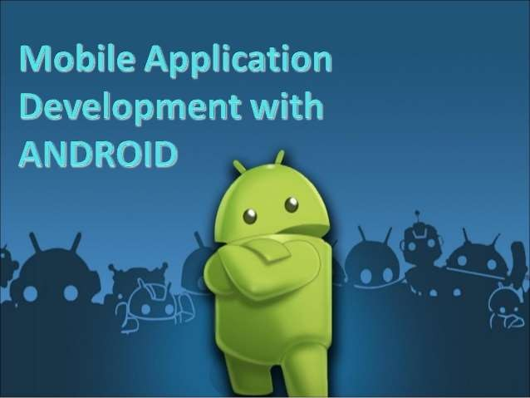
ABSTRACT
No service is required.
Increasing use of smart android phone.
Easily handled technology.
Bluetooth chat app allow to see the other user of Bluetooth chat app around it.
When we start the Bluetooth chat app and we forget to start the Bluetooth of the device it will ask to turn it on.

Slide 4
OBJECTIVES
Two way text messaging.
Develop and Implement chatting system without use of server and internet
Create an Android Mobile Application to provide a consistent UI to interact with the system.
Better use of mobile phones to use this technology.
Encrypt messages.

Slide 5
SYSTEM REQUIREMENTS
Hardware
Android Device
Computer System
Software
Android Studio

Slide 6
FUNCTIONALITIES
Scanning for other Bluetooth devices.
Querying the local Bluetooth adapter for paired Bluetooth devices.
Displaying paired devices.
Chatting over the mobile through Bluetooth connectivity.

Slide 7
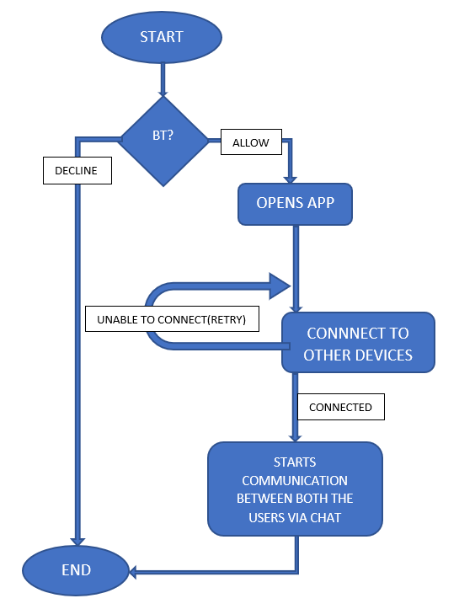
FLOW CHART

Slide 8
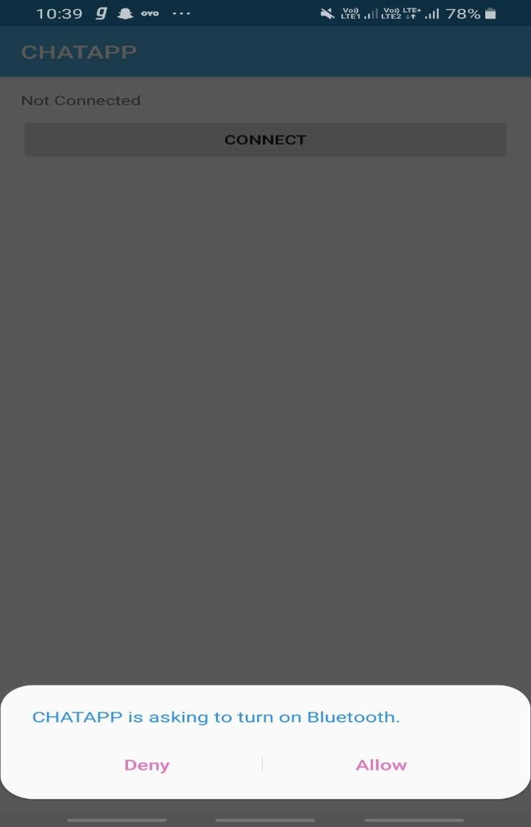
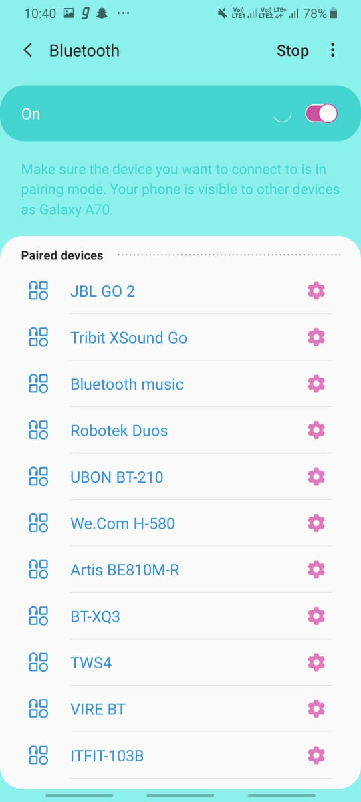
SNAP SHOTS
When we open our app and if we didn’t turn on Bluetooth they will ask to turn it on.
After getting the permission to turn on Bluetooth, our app will start scanning near by Bluetooth devices

Slide 9
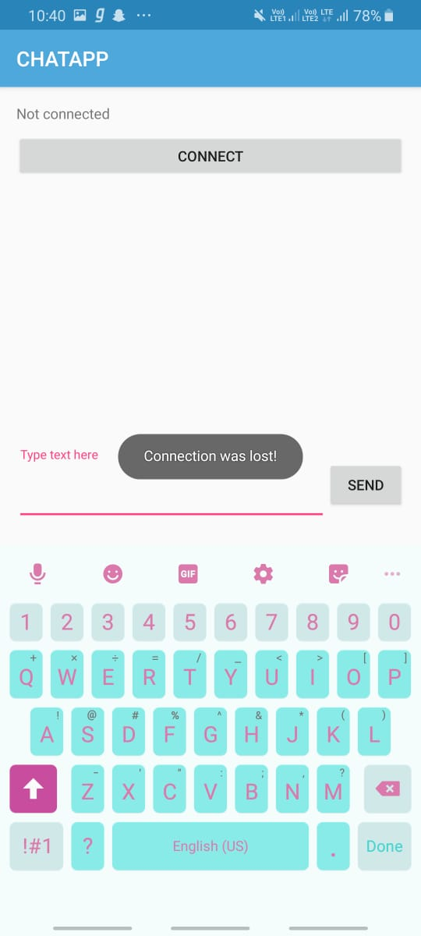
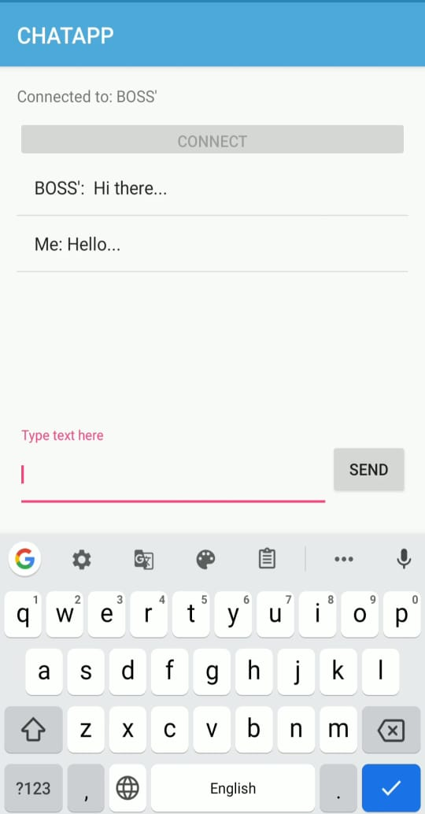
SNAP SHOTS
When no Bluetooth device found it will display toast “connection lost”.
When connection is perfect we can chat with the connected device

Slide 10
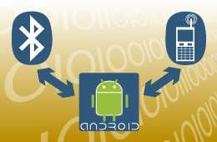
ADVANTAGES
Chatting has largely been a PC based addiction. But when it comes to chatting over cell phones the alternative are costly like SMS chat.
Bluetooth does not require any cables and wires.
The processing and battery power it requires in order to operate is very low.
It is very easy since anyone can figure out how to set up a connection and sync two devices to ease.
This technology is free for use and no charges to be paid.

Slide 11
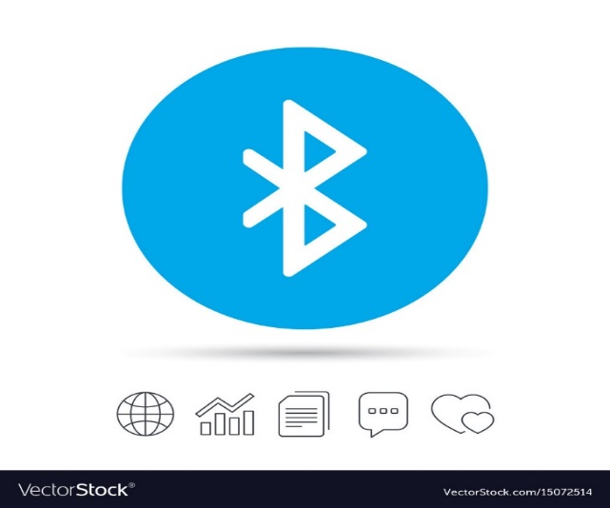
LIMITATIONS
We can’t chat when we are at longer distance.
We can’t share files (like .pdf, .jpeg etc.) with this app.
We can’t connect multiple devices at the same time.

Slide 12
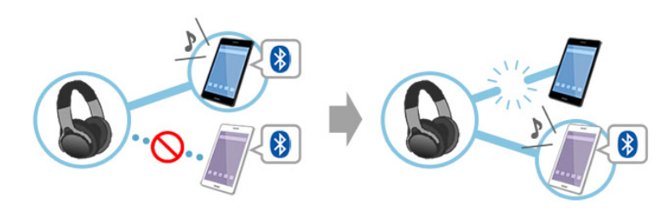
FUTURE ENHANCEMENT
As we all know that the range of Bluetooth is short so we are trying to extend the range of our application working.
As Bluetooth devices can't connect to multiple once it is connected to one device. So we are trying to make a Multiuser Bluetooth chat app.
In our Chat app we can’t send emoji's to express our emotions so we are trying to solve this problem in future.

Slide 13
REFERENCES
1)Android Studio Tutorial
https://www.tutorialspoint.com/android/android_studio.htm
2)Bluetooth Connectivity
https://www.tutorialspoint.com/android/android_bluetooth.htm
3)Chatting
https://www.applozic.com/blog/android-chat-app-tutorial-using-android-studio/
4)How Bluetooth Works
https://electronics.howstuffworks.com/bluetooth.htm

Slide 14

THANK YOU!!

